Slide 1


12/12/2024
WEBSTORE
.NET
Shoping Store

Slide 2

PROJECT BRIEF
•A full-stack web application simulating an online store.
•Allows users to browse products, manage a cart, and place orders.
•Admins can manage inventory, users, and orders.
•Designed for small to medium businesses looking to establish an online presence.

Slide 3
PROJECT GOALS
Create a functional and user-friendly online shopping experience.
Learn and implement full-stack development principles.
Improve skills in frontend/backend integration.
Provide a scalable foundation for real-world e-commerce applications.

Slide 4
TECHNICAL DETAILS
Frontend
1
HTML
3
ASP.NET Core
2
CSS (Bootstrap)

Slide 5
TECHNICAL DETAILS
Back-end
1
ASP.NET Core
2
Programming Language: C#
Database
1
Database Management System: SQL Server

Slide 6
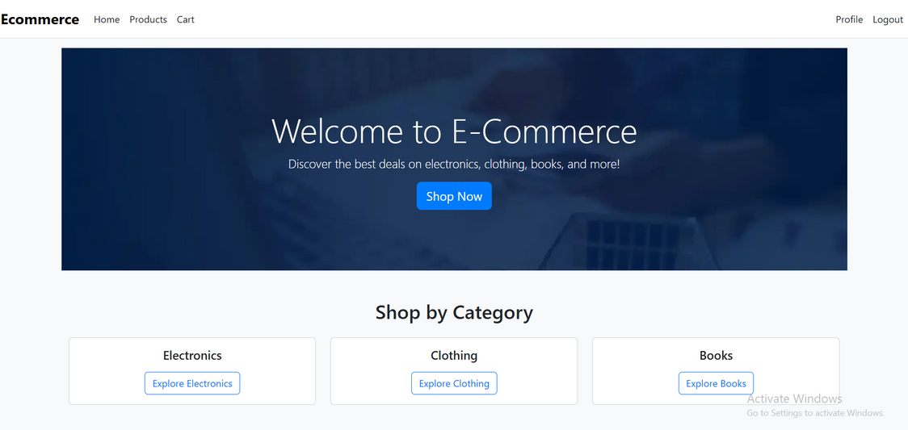
STEP 1: LANDING PAGE:
USERS ARRIVE AND VIEW FEATURED PRODUCTS.

Slide 7
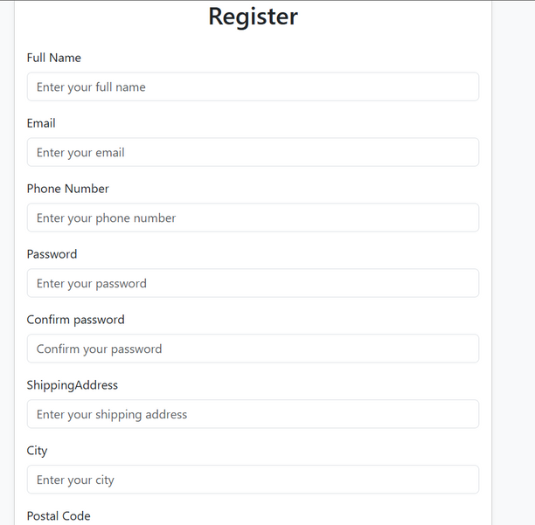
STEP 2: USER ACCOUNT
REGISTER: USER CREATE PROFILE

Slide 8
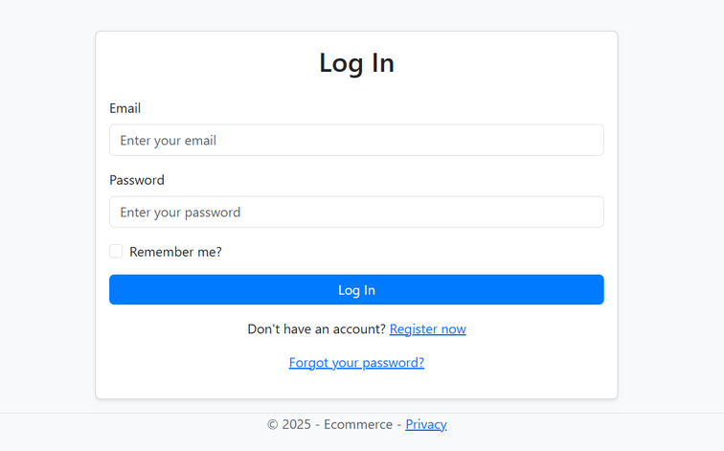
STEP 2: USER ACCOUNT
LOGIN

Slide 9
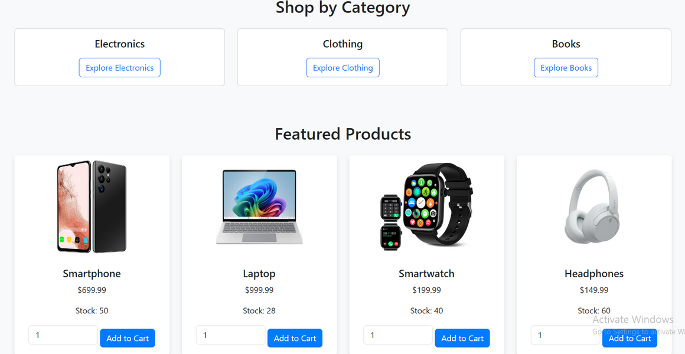
STEP 3: BROWSE PRODUCTS
USERS FILTER AND EXPLORE THE PRODUCT CATALOG.

Slide 10
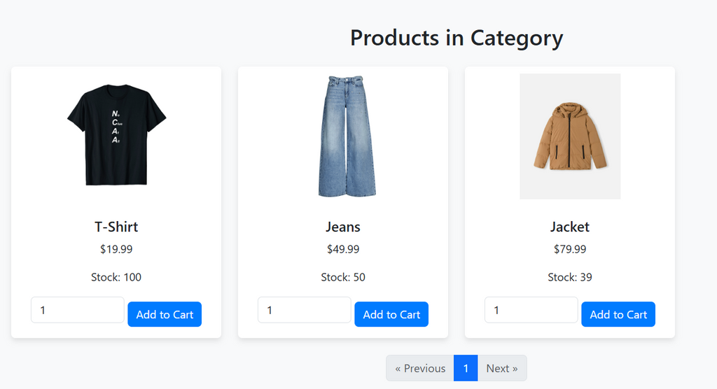
STEP 4: PRODUCT DETAILS
VIEW PRODUCT INFO, IMAGES, PRICE, AND AVAILABILITY.

Slide 11
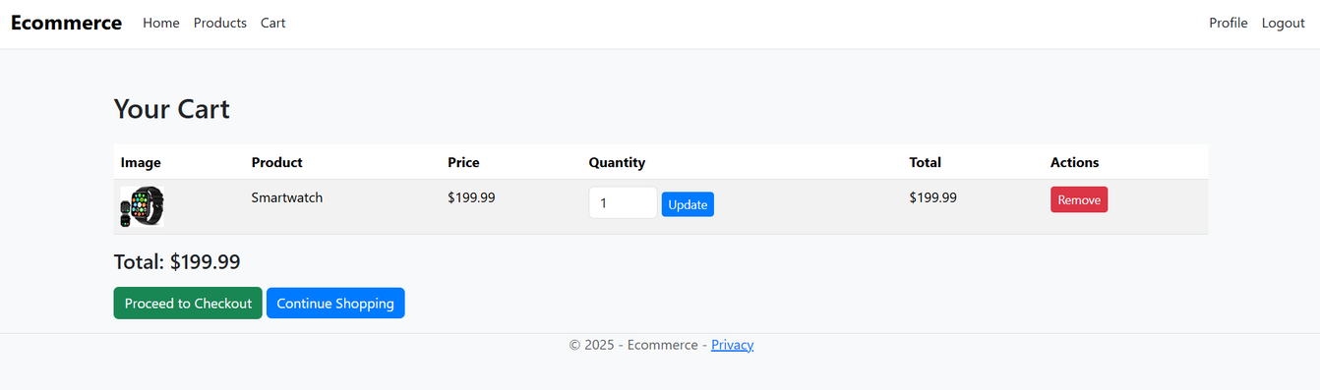
STEP 5: CART MANAGEMENT
ADD, UPDATE, OR REMOVE ITEMS FROM THE CART.

Slide 12
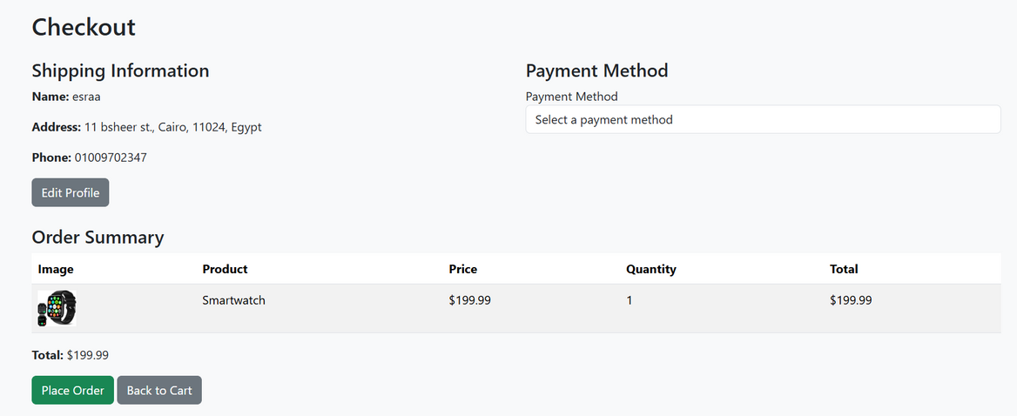
STEP 6: CHECKOUT
ENTER SHIPPING/PAYMENT INFO AND CONFIRM ORDER.

Slide 13
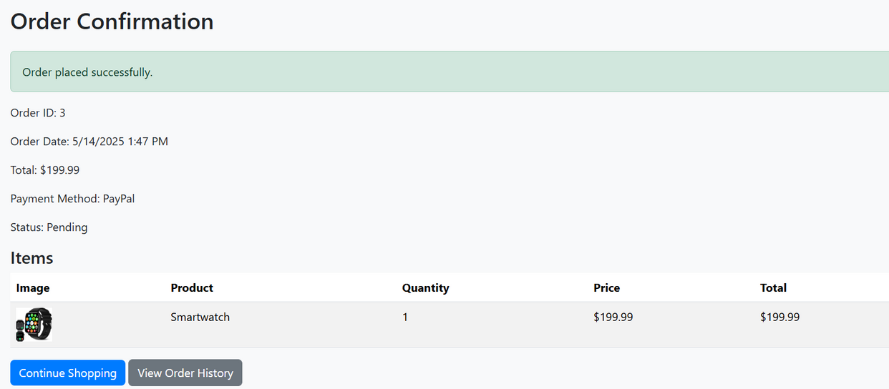
STEP 7: ORDER CONFIRMATION
ENTER SHIPPING/PAYMENT INFO AND CONFIRM ORDER.

Slide 14
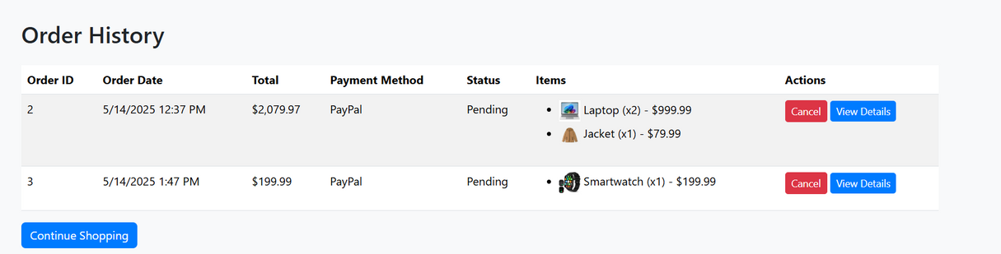
STEP 8: ORDER HISTORY
USERS CAN VIEW PAST ORDERS AND STATUSES.

Slide 15
MARKETING STRATEGIES
Social Media Campaigns
Instagram/Facebook ads targeting niche markets.
SEO Optimization
Improve visibility with targeted keywords and meta tags.
Welcome emails, abandoned cart follow-ups, promotions.
Email Marketing

Slide 16
MARKETING STRATEGIES
Influencer Collaborations
Partner with micro-influencers for reviews and exposure.
Content Marketing
Blog posts about product uses, trends, and how-tos.

Slide 17
THANK YOU!
Group 3:
Esraa Magdy Fareed
Zahraa Mostafa Mohamed Selim
Engy Ahmed Noman Yousef
Menna Abdelmouty Abdelmaksoud

